Slide 1
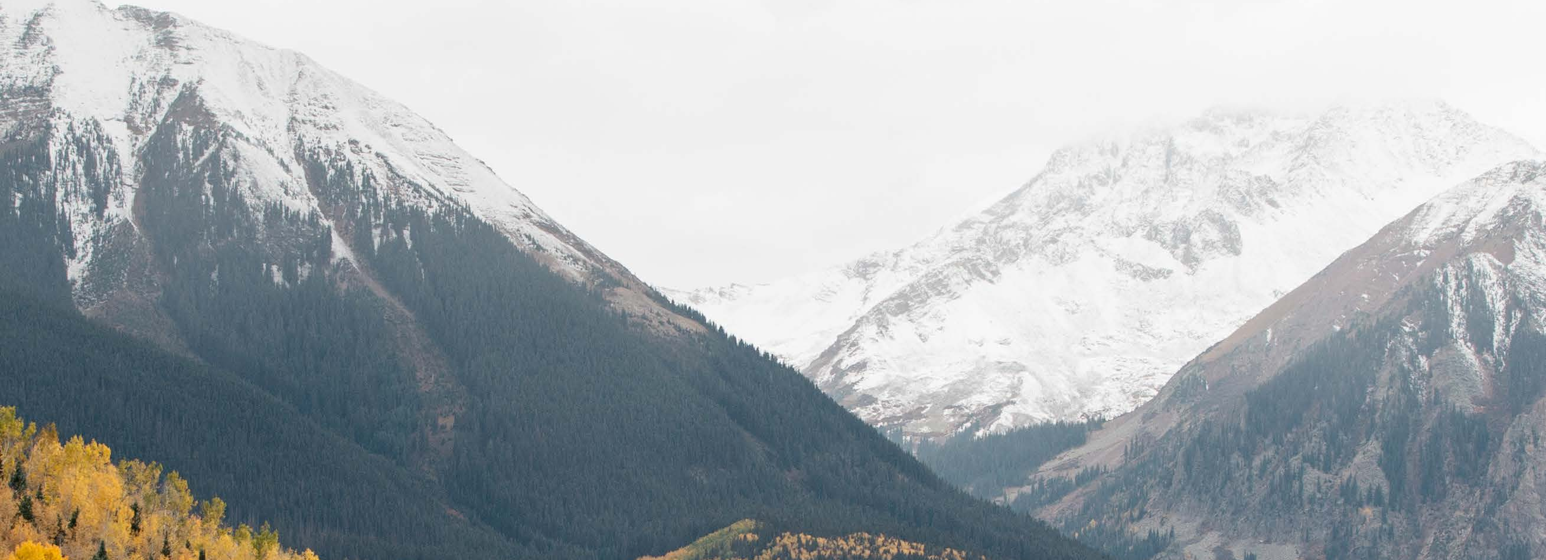


Academic Advising | Enhancing your First-Year Experience
University exploratory studies program
Advising framework
UESP Mission
UESP is the academic home for undecided/exploratory students at Oregon State University. The mission of UESP is to provide academic advising and major and career exploration assistance to undergraduates, both new and transitional, who wish to investigate the educational opportunities available at OSU. In accordance with OSU’s mission, we strive to enhance the OSU learning environment for our students.
The UESP advisors aim to assist students in making well-informed decisions regarding degree programs and course selection, obtaining accurate information regarding academic programs of study, making connections with academic college head advising offices, assessing career goals in relation to interests, skills and values and accessing other sources of assistance and student support provided by OSU.
UESP Advising Team
Kerry Kincanon
Director of New Student Advising and UESP Kerry.Kincanon@oregonstate.edu
Shannon Shivers
Academic Advisor Coordinator
Shannon.Shivers@oregonstate.edu
Adam Hinkley
Academic Advisor Coordinator
Adam.Hinkley@oregonstate.edu
Michele McAuliffe
Academic Advising Specialist
Michele.McAuliffe@oregonstate.edu
April Winz
Graduate Teaching Assistant/Academic Advisor
April.Winz@oregonstate.edu
See more information about our team at: https://beav.es/pUW
UESP
102 Waldo Hall
Corvallis, OR
97331-6402
Website:
uesp.oregonstate.edu
Appointments:
Call 541-737-8144
or book online through
https://beav.es/pUW

Slide 2
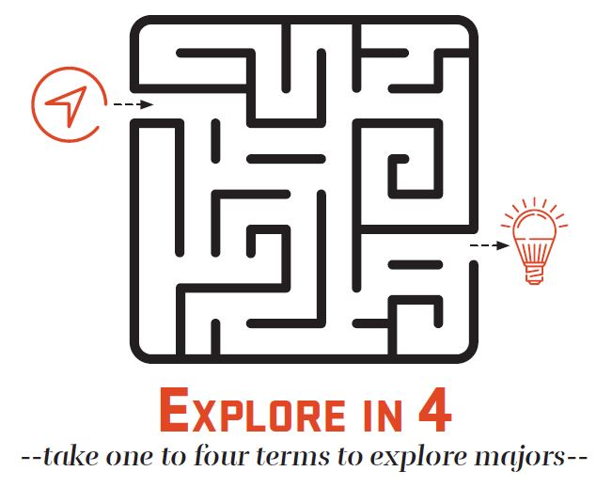
UESP Advising Outcomes
Per the university requirement, UESP students should complete a Transitions course in their first term at OSU (summer admits can take this class in fall term) and ideally should take their WR 121Z class for Writing Foundations in their first year.
UESP students should know how to access and utilize Beaver Hub, OSU’s student portal, and MyDegrees, OSU’s online degree audit system.
UESP students should engage with active exploration activities and resources.
UESP students should pursue involvement outside of the classroom.
UESP students should set goals related to major declaration in alignment with UESP’s defined major–decision making process.
In UESP, we believe in exploration, and we also believe there are benefits to being declared. We DON’T want you to fall behind in your degree progress. That is why we want you to be active in your exploration process. Once you start with UESP, we give you 4 full terms (not including summers) before you need to declare a major.
What Happens in UESP Advising Appointments?
You are welcome to meet with your UESP advisor as frequently as you need, but we do require a mandatory face-to-face advising appointment at least once a term to help you to examine current experiences, plan for future ones and move forward on deciding on a major. This appointment should occur prior to your registration for the next term. You should plan on scheduling this 30-minute appointment between weeks 3 and 8 each term if possible. When scheduling, it is best to initiate contact no later than the end of week 5, so you can be assured to get in prior to your priority registration date. You receive your registration pin during this appointment.
During appointments, you may...
Discuss what you like and dislike about your courses and reflect on your learning thus far.
Discuss intentional exploration activities that could help you move forward with your major decision-making.
Discuss campus or online resources that might support any academic or personal concerns/challenges you have faced.
Revisit the degree components (Core Ed or Bacc Core, major requirements, etc.) and discuss the implications of that towards your next term course possibilities.
Review the “tools” related to exploration and degree progress (MyDegrees, Online Catalog, etc.).
Refine or develop a list of potential courses and get your advising registration hold cleared.
Discuss co-curricular/experiential education participation and opportunities, as your advisor may have suggestions for out-of-classroom involvement related to your interests.
1500 SW Jefferson St. | Corvallis, OR 97331
541-737-1000

Slide 3

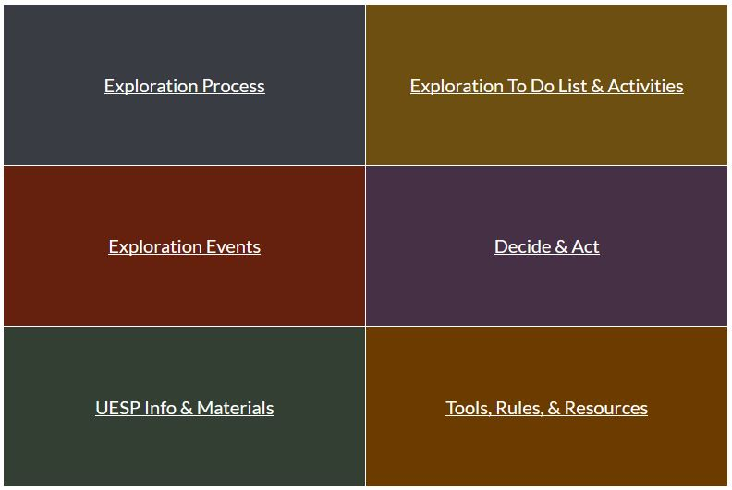
UESP Canvas Studio Site
In the next few days, we’ll enroll you in a UESP studio site that will show up for you when you log into Canvas. Your UESP Canvas studio site has helpful information about UESP and the broader university and various exploration activities that you can access on your own or that your advisor may encourage you to use to help you work through the major exploration process. Here is what the landing page for the studio site looks like:

Slide 4



Academic Advising | Enhancing your First-Year Experience
University exploratory studies program
Exploration To-do list
What exploration activities will you pursue?
facebook.com/UESPadvising
Exploration Activity | Fall | Winter | Spring
Take ALS 192: Intro to Academic and Major Exploration
Review the “What Can I Do with My Major” site on the Career Development Center website
Complete a self-assessment inventory (Focus2 – on the Career Development Center website)
Run a “What If” scenario in MyDegrees for a major of interest
Meet with professors in a major of interest
Meet with an academic or career advisor in a major of interest
@OSU_UESP
@OSU_UESP
UESP
102 Waldo Hall
Corvallis, OR
97331-6402
Website:
uesp.oregonstate.edu
Appointments
Call 541-737-8144 or visit - https://uesp.oregonstate.edu/uesp-staff-list
More activities on the back

Slide 5
Exploration Activity | Fall | Winter | Spring
Seek input from peers in a major of interest
Seek input from friends or family members
Attend an open house, info session, or event for a major interest (e.g. Fridays in Austin, Undergrad Engineering Expo - https://uesp.oregonstate.edu/exploring)
Attend a Career Fair or Expo : https://career.oregonstate.edu/career-fairs
Take a class (or classes) specifically to learn more about a major of interest
Review the online catalog and/or department web sites to learn more about a major of interest
Complete an informational interview
Engage in a job shadow for a career area of interest
Use resources on the UESP web site (O*NET, Occupational Outlook Handbook,) - https://uesp.oregonstate.edu/exploring
Join a student organization related to a major of interest
Participate in a service learning (or community service) project
Other:
Reflection:
What have you learned from these exploration experiences?
Which experiences did you enjoy? What was helpful about those particular experiences?
In what ways have these experiences matched up with your interests? Your skills? Your values? Your personality?
What unanswered questions do you still have about the specific majors you’ve been exploring at OSU?
1500 SW Jefferson St. | Corvallis, OR 97331
541-737-1000

Slide 6

Exploration This Week
https://uesp.oregonstate.edu/exploring
Interest comes with experience, so we are constantly on the lookout for events and opportunities that UESP students can use to get perspectives and insight on different majors and careers. We include information about these upcoming events on our “Exploration This Week” website.
At the beginning of each week during the term, we’ll send you a message to your Oregon State Email address that highlights any upcoming deadlines or important information about advising and registration, and we include a link to the Exploration This Week website with bullet points on the good exploration events for that week. Please read this email! We keep it short and sweet, but we want to keep you informed on exploration opportunities.

Slide 7
For anyone starting at OSU in the summer of 2017 or after, UESP is implementing a 4-Term Limit for students to explore major options via our program.
Why? A few reasons…
There are benefits to exploration, and there are benefits to being in a declared major. Data gathered by EAB shows that there is a “Productive Exploration Window”, and that students who do their exploration within the first 4 terms are more likely graduate in 4 years. Extend beyond that and you increase the likelihood of a longer time-to-degree.
Not everyone graduates in 4 years, but it is a good goal to have. Being a university student is expensive. If you are in a situation where you can be aggressive with your exploration and your degree progress, that will help you manage those costs.
Majors will sometimes have “majors-only” restrictions on their classes, and it is not uncommon for those to start in the second year if not sooner.
Having a time-limit will helps us help you stay on track with your exploration and getting a degree from OSU.
But what if…
I declare and then decide I’m not happy with my choice and want to return to UESP?
  If you haven’t exhausted your 4-term limit, then it is fine to come back to UESP. At the beginning of the next full term, we’ll just start the term-limit clock where you left off.
  If you have, then you still have access to UESP advisors for major exploration discussions via non-UESP appointments.
  You can petition for extension.
I exhaust my UESP eligibility and can’t get into my first choice of major because I don’t have high enough grades?
  Parallel plans will be part of the discussion throughout the advising relationship, but especially in terms 3 and 4. It is good for every student to have an alternative option in mind.
  If the major is realistically within reach for you within another term or two, you can pursue the petition for extension.
I take a break and take a term or multiple terms off from school?
  Only enrolled terms at OSU count towards the 4-term limit.
What about summers?
Summer terms are not counted. We only factor fall, winter, and spring into the term limit count.
What is this “Petition for Extension” you mentioned multiple times?
Good question. This is a process that provides an exception for unique circumstances where you truly need more time to explore or before you can declare into your desired major. If you get to your 4th term with us, and you haven’t declared, we are going to withhold your registration PIN and ask you to justify why you need to stay in UESP. You’ll provide this justification via an online petition form.
EAB (2016). Promoting timely degree completion: reconciling student choice and the four-year graduation imperative. Retrieved on April 21, 2017 from https://www.eab.com/-/media/EAB/Research-and-Insights/AAF/Studies/2016/Promoting-Timely-Degree-Completion/34022_EMF_AAF_Timely_Degree_Completion.pdf

Slide 8
Additional Resources for Exploratory Students
As you begin the process of exploring academic and career options, remember that there are a host of available resources and support services that can assist in your process.
Academic Coaches & The Learning Corner
Academic Coaches work with students on study skills and strategies in areas such as time management, note-taking, and exams prep. The coaces are part of the Academic Success Center in Waldo 125. You can make an appointment with a coach online at https://coolkidsgetcoached.acuityscheduling.com/schedule.php. The Learning Corner is a part of the Academic Success Center’s website that provides information, tips, and strategies to help you maximize your learning and success. Explore this resource at https://success.oregonstate.edu/learning-corner
Academic Success Course (ALS 116)
The Academic Success Center, coordinates this 2-credit course, which focuses on a range of academic topics geared to give you tools and strategies to help you achieve your academic goals. Contact your UESP advisor for more information.
Basic Needs Center
It can be tough to find the bandwidth to explore if you are lacking basic needs. This center is an excellent resource if you are experiencing food, housing, or financial insecurity. Read more about the Basic Needs Center here - https://studentlife.oregonstate.edu/bnc
Counseling and Psychological Services (CAPS)
CAPS provides confidential and free individual, group, and couples counseling, as well as consultation services to students. These services are designed to help students understand themselves better, create and maintain satisfying relationships, improve their academic performace, and make healthy and satisfying career and life choices. Their primary location is the 5th floor of Snell Hall, but they also subscribe to an awesome app based service from Telus Health called Anytime Anywhere that you can literally access anytime, anywhere. You can read more about CAPS services here - https://counseling.oregonstate.edu/main/accessing-caps-services
Disability Access Services
Students who have a documented disability or believe that they have a disability potentially have access to a wide variety of academic support services. For further information contact the DAS office in A200 Kerr Administration, at 541-737-4098 or 541-737-3666 TDD or visit their site - https://ds.oregonstate.edu/.
Diversity and Cultural Engagement (DCE)
DCE coordinates initiatives and programming aimed at inclusion and social justice. They have close affilation with OSU’s cultural centers- Asian Pacific Cultural Center, Ettihad Cultural Center, Lonnie B. Harris Black Cultural Center, Pride Center, Kaku-ixt Mana Ina Haws Native American Longhouse, Hattie Redmond Women & Gender Center, and Centro Cultural César Chávez. The main DCE office is in SEC 228 and can be reached at 541-737- 9030.
Educational Opportunity Program/Student Success & Belowing (EOP/SSB)
EOP provides instructional, counseling, and academic support services to students who are among the following populations: students of color, students with disabilities, single parents, low income students, veterans, 25+, first generation and students from rurally isolated communities. Visit Waldo Hall 337 or call 541-737-3628. EOP/SSB often also supports tutoring for all students, which they conduct in the Cultural Centers.
Learning Support for Math, Chemistry, Physics, and Economics
You can find the Math Learning Center in Kidder Hall 108, the Mole Hole (Chemistry Tutoring) on the 3rd Floor of the Valley Library, the Worm Hole (Physics Tutoring) in Weniger 334, and Economics Tutoring in Bexell 100H.
Supplemental Instruction (SI)
SI is a program that offers peer-led, group study tables for challenging courses. If a class has SI, an announcement will be made the first week. For more info, see https://success.oregonstate.edu/supplemental-instruction
The Undergraduate Research and Writing Studio
The Undergraduate Research and Writing Studio offers free help with any writing task at any stage of the writing process. Their space on the main floor of the Valley Library is a great space to work on your writing assignments. Learn more at https://writingcenter.oregonstate.edu/.
Zero to Success in 77 Days
A week-by-week to-do list for the term. You will get a hard copy of this at START, but you can also download a copy at https://uesp.oregonstate.edu (scroll to the bottom of the home page, and you’ll see an icon that gets you to a PDF of this document).

Slide 9
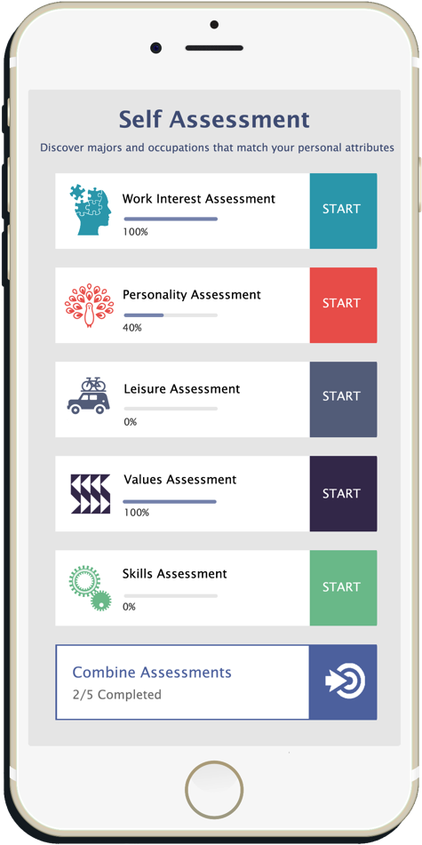
FOCUS 2 for UESP Students
Use on your phone, tablet, or any device.
FOCUS 2 is an online, self-guided system that will help you to identify a major at this college and occupations that best suit you and develop a career and education plan.
Go to: career.oregonstate.edu and click on Students to access FOCUS 2 using your ONID username and password.
Work through each section, completing all requests for your input. You MUST save occupations and areas of study (majors) that interest you or no information will appear in your portfolio!
To discuss your results, schedule an appointment with your academic advisor. You may also follow up with the Career Development Center for more information.
How much time does it take to use FOCUS 2? Typically, the total time spent by students the first time they use the program ranges from 1 to 2 hours. Working through the program does not have to be done in one sitting. You can log back in at any time.

